Slide 1
Welcome to Arizona:
One of the Grandest Places on Earth

Slide 2
Presentation to 2018 Post-Secondary International Network (PIN) Conference Suicide Prevention: Let’s Talk About It
Elizabeth Caspian, MD Medical Director, West Yavapai Guidance Clinic, Prescott, Arizona

Slide 3
Who is WYGC (West Yavapai Guidance Clinic)?
The large majority of WYGC clients receive Medicaid benefits (government health care/low income)
Private insurance contracts are in place for some programs; and sliding fee scale can be accepted
WYGC has programs to serve children and adults
Windhaven Psychiatric is a 16-bed psychiatric unit in Prescott Valley, AZ, serving persons age 18+. Average length of stay approximately 6 days
Other services include: Outpatient counseling and case management; Peer support services for persons with serious mental illness; Psychiatry services; Primary/integrated care; Vocational services for individuals with disabilities; Senior peer prevention program; Substance Use Disorder outpatient and 23-bed residential programs; Supervised and unsupervised housing; 24-hour crisis intervention
The non-profit WYGC will serve some 7,000 people this year
WYGC primarily serves residents of the western portion of Yavapai County – the County is geographically the size of the State of New Jersey

Slide 4
Grand Arizona Sunset

Slide 5
AZ Suicide Data
Suicide, the act of taking one's own life, is a leading cause of death in Arizona
Approximately 1,200 people die from suicide in Arizona each year
There is an estimated 25 attempts for every death by suicide; 100-200 for youth; 4:1 for older adults
Mortality from suicide, which increases steadily through the teens, is the second leading
cause of death at that age
The number of suicides in Arizona are triple the number of homicides
Arizona ranks in 17th in the US for highest rate of suicide; 6th for older adults and 19th for youth ages 15-24
Data: Arizona Suicide Prevention Coalition, 2018; compiled from Amer. Assoc. of Suicidology, CDC, AZ Child Fatality Review Reports, and AZ Injury Data Report

Slide 6
Yavapai County Suicide Data
In 2016, 1,271 Arizonans died by suicide
That same year in Yavapai County, 69 people died by suicide. That figure has been trending up since 2010.
Yavapai County’s per capita suicide rate is the highest in Arizona
At least 101 Yavapai County citizens ending their life by suicide in 2017
Hard to believe? Prescott is ranked consistently in top places to retire, live and play nationally.
Source: Yavapai County Board of Supervisors proclamation Sept 2018 for Suicide Prevention Awareness Month. And Prescott Daily Courier.

Slide 7
Worldwide concern regarding increase in suicides
Globally, over 800 000 people die of suicide every year and it is the second leading cause of death
in 15-29-year-olds (WHO, 2014). However, since suicide is a sensitive issue, it is very likely that it is
under-reported because of stigma, criminalization in some countries and weak surveillance systems.

Slide 9
Mental Health & US College Students
Research shows 1 in 5 university students is affected with anxiety or depression
In Spring 2017, nearly 40% of college students said they had felt so depressed in the prior year that it was difficult for them to function
Young adults between the ages of 18-25 are at highest risk for opioid use problems
Source: Mental Health First Aid, with reference to American College Health Association and NBC News

Slide 10
Post secondary educational experience is a time of transition, mixed with hope for a better future.
Many psychosocial developmental tasks to be managed: relationship skills, role of chemical recreation in ones life, time management, dance between pleasure/pain, maintaining self esteem and accepting non-perfection.
Easy to become confused, disillusioned and rattled with emotional pain. Suicide can feel like the answer to stopping emotional pain. Poorly managed relationship to recreational chemistry increases the odds a person will act upon suicidal thoughts.

Slide 11
What We Are Doing
The rate of suicide completions among our enrolled WYGC client population is lower than the rate of the general Yavapai County population. Engagement in professional services appears to be a protective factor.
Provide Mental Health First Aid training for Yavapai College resident assistants in August, and Prescott College resident assistants previously. At no charge, through our WYGC Foundation.
Increase access to services through our Crisis Stabilization Unit

Slide 12
Increasing Access To Care Through CSU
In its first year since opening June 21, 2017, the Crisis Stabilization Unit (CSU) served 2,950 people.
Law Enforcement personnel brought 387 of those people, avoiding jail and emergency rooms.
Local acute hospital data show numbers of people seeking psychiatric and substance use related care down and psychiatric boarding times decreased
Yavapai County Jail is tracking and reporting positive impact
Primary reason for coming to CSU relates to Opiates or Alcohol. People are expressing suicidality, whether they have taken substances or not.
Many people are assessed, safety planned and sent home, or to ER, or to other levels of care… not all people admitted to a chair or bed. all walks of life and all socio-economic backgrounds.
Utilization by people from Latest addition is Paramedics. Allows better initial medical screening.
Suicidality or homicidality are not requirements for coming to CSU and/or being admitted to CSU.
Peers on site to support and provide hope, an important part of the program

Slide 13
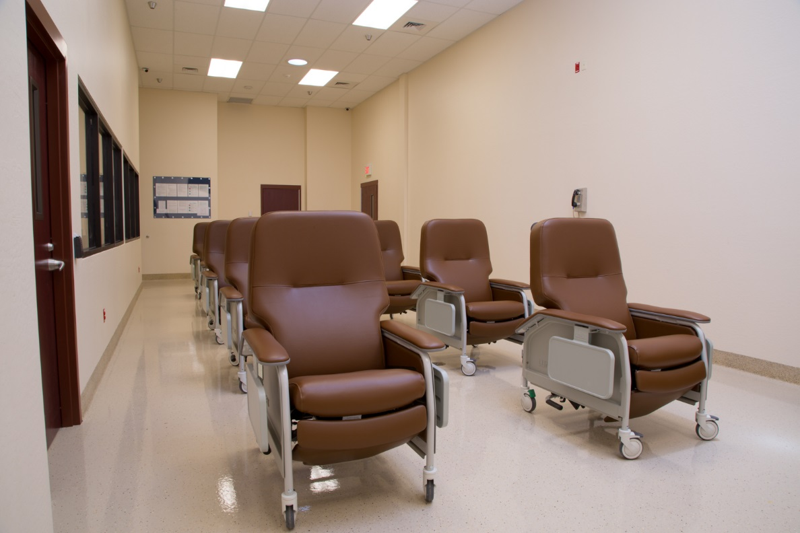
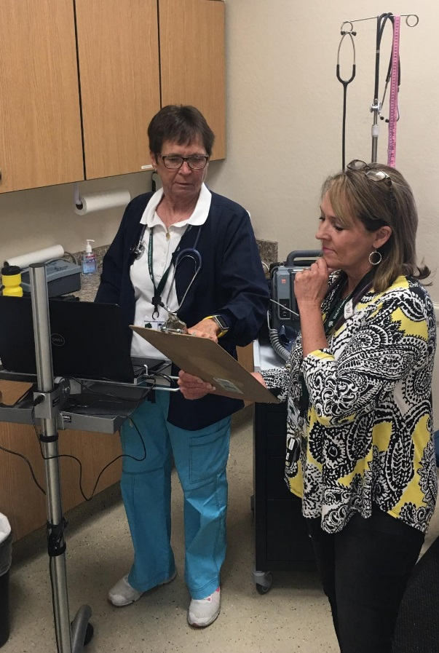
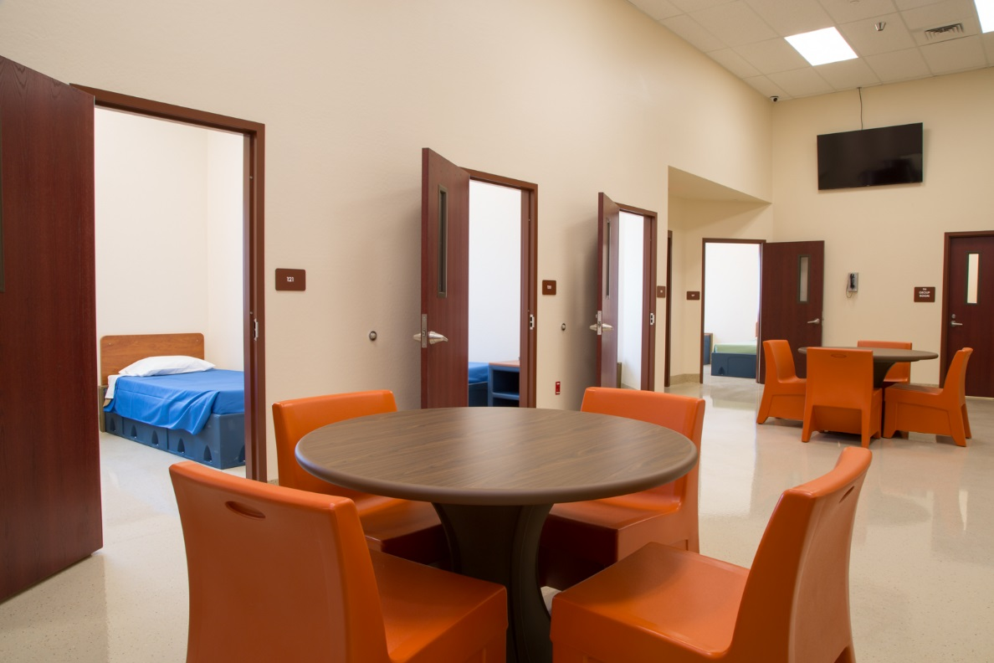
CSU

Slide 14
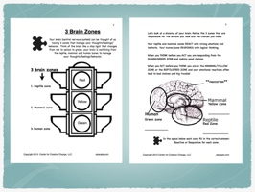

Slide 15
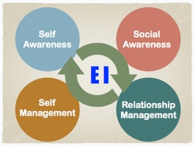

Slide 16
Stigma Reduction:
The Priority for
Sucicide Prevention
Brain Awareness Opens the Door to Talk About Difficult Emotional Expriences

Slide 17
Access to care
Consider this: It is not developmentally appropriate for college students to ask for help.
They are trying to establish their identity, separating from authority figures.
Reaching out to these same figures in times of severe stress, depression or suicidality is counter-intuitive.
Would peers (RA’s) be the point of contact and intervention for focus?

Slide 18
Access to care
A large-scale multisite study of gatekeeper training programs to increase utilization of mental health services among college students showed mixed results
Trainees (Resident Advisors) experienced improved outcomes in self-perceived knowledge, ability to identify students in distress, and confidence to help.
However, utilization of mental health services in student communities did not increase
How do you enhance the links and increase this utilization?
Journal of Adolescent Health, 2014, Gatekeeper Training and Access to Mental Health Care at Universities and Colleges; randomized control trial on 32 colleges and university between 2009 and 2011.

Slide 19
How Yavapai County mirrors a college campus
Many sober living homes and substance abuse treatment centers are located in the Prescott, Arizona area. They struggle with a life of sobriety, when around them all signs are to drink or drug.
Very few people complete suicide sober; so the use of substances within Yavapai County and on a college campus increase the risk.
Our local Veterans Administration Health Care Hospital and Outpatients services draws those at higher risk for suicide to the community for health care services, and potential for relocation.

Slide 20
What We Are Doing
We don’t have ‘THE’ answer
We work collectively within the community to find it
Yavapai County Suicide Prevention Coalition and Yavapai Mental Health Coalition, both of which involve WYGC, lead the way
The numbers can be daunting; but we don’t give up

