Slide 1
Future-Ready: Skills for the New World of Work
Notes:
DO NOT READ
Description of session:
The constant onslaught of new technology, such as artificial intelligence (AI), is quickly changing the world of work. We will soon see some occupations completely automated as others change dramatically to leverage newly available technologies. At the same time, the structure of the labour market is changing – the new gig economy, combined with the ever-evolving technological landscape, requires a revolutionary approach to traditional postsecondary education. Canada’s colleges and polytechnics are up to the challenge. This presentation will focus on how these institutions are taking innovative approaches to meet the future demands of the labour market, preparing the workforce of tomorrow.

Slide 2
Outline
College and Institutes Canada
Global context
Global trends and challenges playing out in PSE
how Canadian colleges and institutes are responding
international innovations of note
Notes:
It is my pleasure to be with you today to first, tell you a little bit about CICan and what’s happening across Canada, and globally, as it relates to the post-secondary landscape.
I’ll touch on some of the big trends and challenges in our sector look at examples of what CICan’s extraordinary members are doing to meet these opportunities head on in Canada, ensuring graduates have the skills they need for the new world of work.

Slide 3
The Voice of Canada’s Colleges and Institutes
Founded in 1973, Colleges and Institutes Canada (CICan) is the national and international voice of Canada’s publicly supported colleges, institutes, cégeps and polytechnics.
Notes:
I am here as the president and CEO of CICan – the national and international voice of Canada's publicly supported colleges, institutes, cégeps and polytechnics: the applied learning sector

Slide 4
Canada’s extensive network of colleges and institutes serves students in urban, rural and remote communities thanks to more than 420 campuses and 80 additional learning, training or access centres
Notes:
Our extensive network of colleges and institutes serves students in urban, rural and remote communities all over the country thanks to more than 500 locations across Canada, including campuses, and research, training and access centres.
Colleges and institutes are the providers of career-oriented, cutting-edge applied learning in Canada. They offer a huge range of credentials and educational pathways to students of all kinds. The de-centralized nature of education in Canada allows colleges to respond to the needs of local communities, diverse learners and the indigenous population.

Slide 5
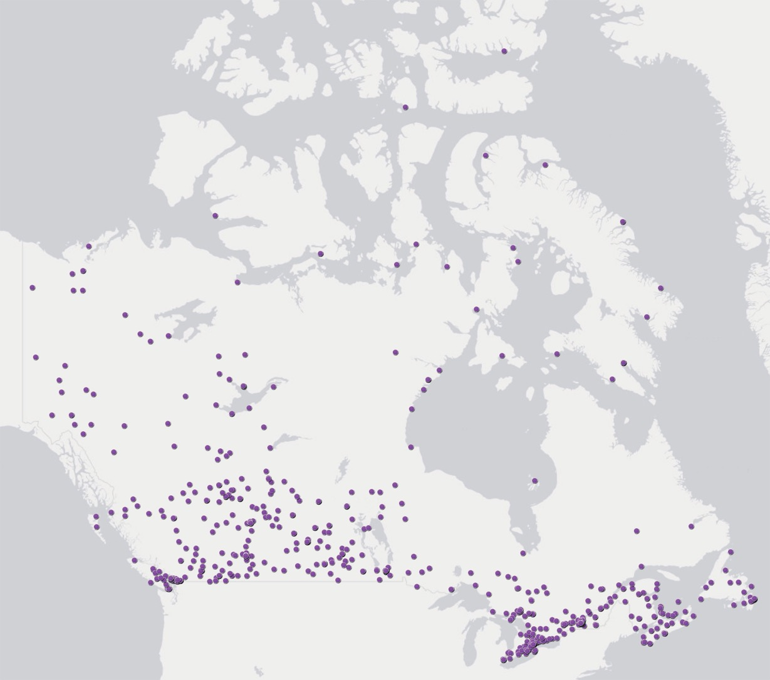
collegesinstitutes.ca/members
Notes:
Here are all of the physical locations of CICan members in the country. Canada is huge, and sparsely populated, which makes this incredibly impressive.
CICan’s Members are within 50km of more than:
95% of the Canadian population
3,500 communities
1.3M (over 80%) Indigenous Canadians
And over 1,800 rural and remote communities, representing over 65% of the total rural and remote population of Canada

Slide 6
Unique value proposition:
Pathways
Applied research
Degree granting
Post graduate credentials
Close relationship with industry
Work-integrated learning (WIL); Program Advisory Committees (PACs)
Notes:
Most education systems have very specific types of institutions that offer TVET (e.g. Institutes of Technology, Technical Colleges and Technikons – universities of technology; etc. but Canadian colleges and institutes have a broad-based mandate to offer both vocational and general (academic) training. The de-centralized nature of education in Canada allows colleges to respond to the needs of local communities, diverse learners.
Their unique value proposition lies in:
Pathways
Applied research
Degree granting
Post graduate credentials
Close relationship with industry (eg WIL on-the-job experience and PACs

Slide 7
Global Context
Notes:
Now, let’s set the scene for the global trends and challenges I will be discussing…

Slide 8
Notes:
You have all heard about the so-called fourth industrial revolution that is upon us where ALL companies are now technology companies. There is no question about whether or not your sector will be changed by technology, simply HOW it will be changed. The way we work, live, play and learn is all changing.

Slide 9
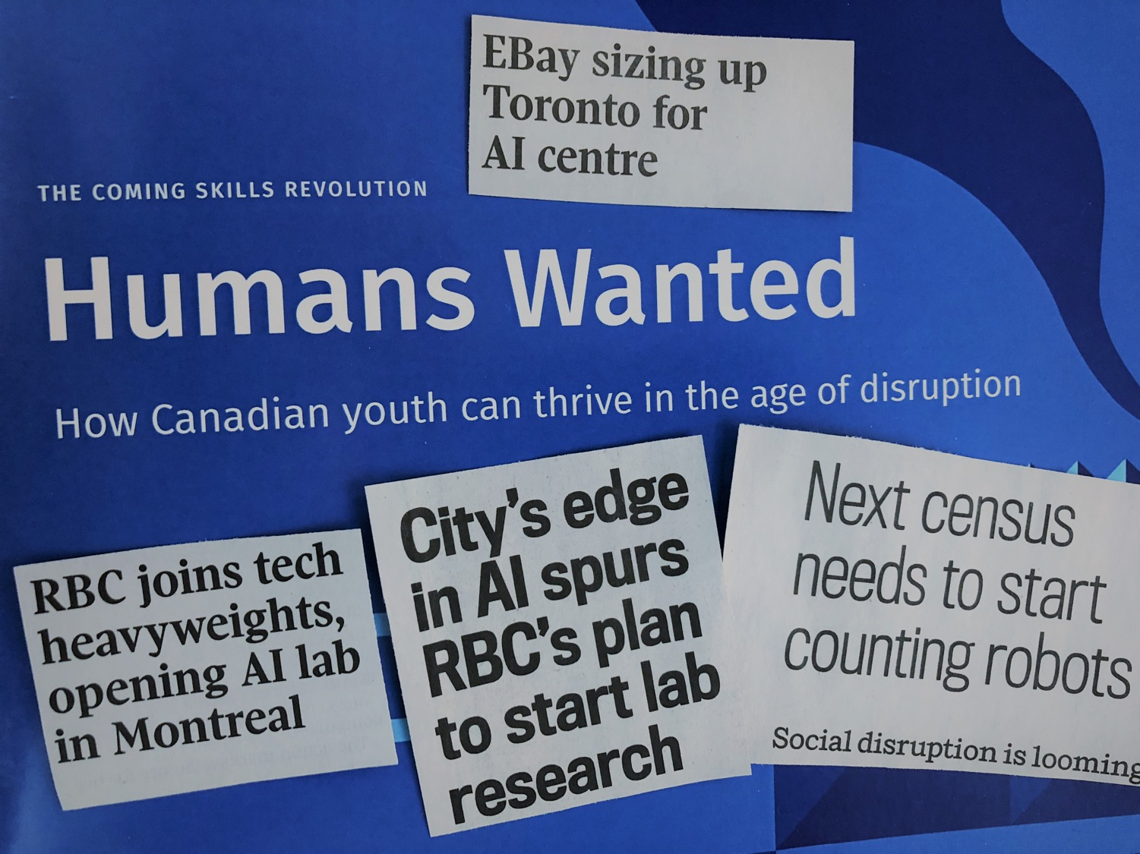
Notes:
If you read the news these days, you would be forgive for thinking that robots are taking over the world! Two of my favourite headlines are:
“You Will Lose Your Job to a Robot—and Sooner Than You Think.” and “Robots May Steal as Many as 800 Million Jobs in the Next 13 Years.”

Slide 10
Job loss to automation: wild predictions!
OECD study: 9% of jobs in 21 member countries are automatable
McKinsey: 400 million to 800 million jobs worldwide could be automated by 2030
Notes:
This topic is so hot that MIT Technology Review decided to start keeping tabs on all the numbers different groups have come up with about predicted job losses (and some gains) at the hands of automation, robots, and AI.
As you can see, no one agrees. Predictions range from optimistic to devastating, differing by tens of millions of jobs even when comparing similar time frames. Of course, not all statistics are created equal so I have chosen to highlight an OECD study suggesting that 9 percent of jobs in the organization’s 21 member countries are automatable, and a McKinsey report from last year that said 400 million to 800 million jobs worldwide could be automated by 2030. And let’s not forget the fact that countries like Germany with high rates of automation are thriving with low unemployment rates!

Slide 11
Notes:
This a great analysis of the jobs at highest risk for elimination, and the protective effect higher education can have – any compensation and benefits managers in the audience?!
We aren’t quite there yet, but the future of international higher education is absolutely shaped and changed by global phenomena like automation, and it is our job to address this.
(where is this from?)

Slide 12
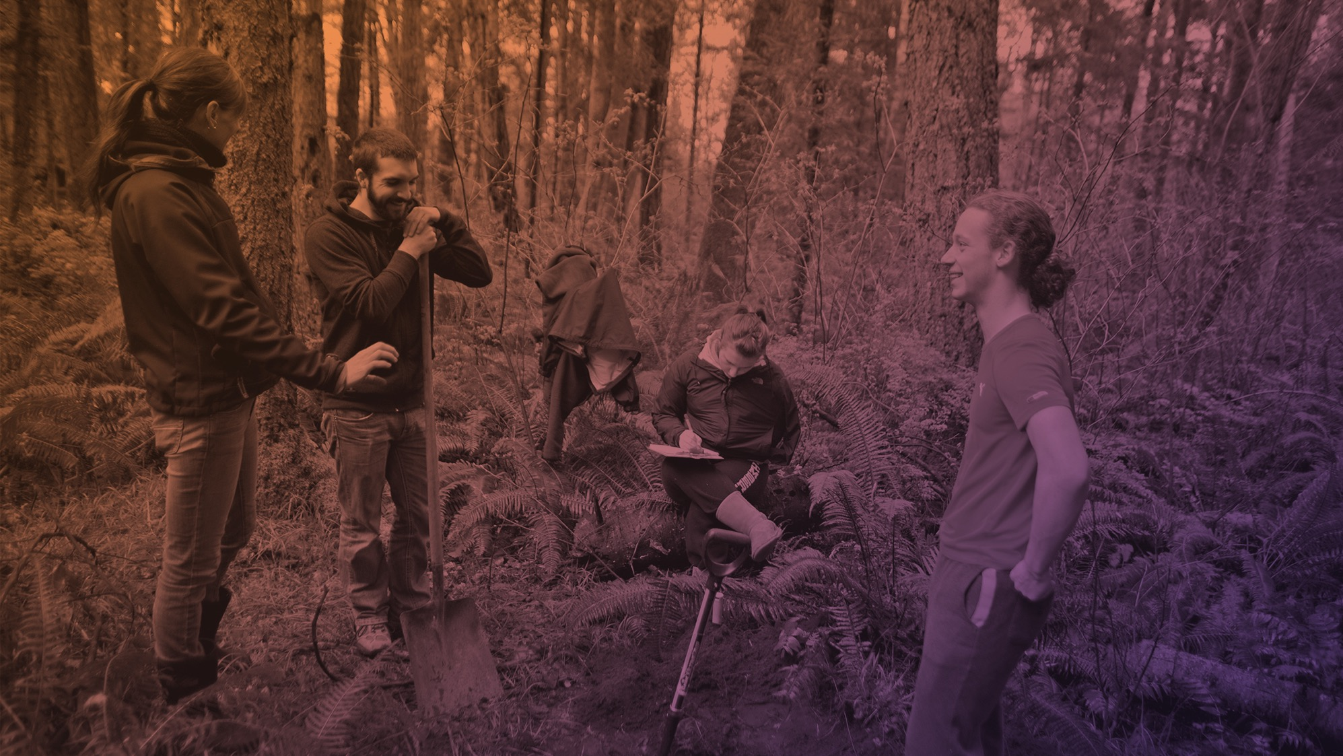
Global Trends and Challenges
Notes:
Now lets look more closely at some of the major global shifts that are bearing influence in post-secondary education, and look at some examples of how Canadian and international post-secondary institutions are tackling them.

Slide 13
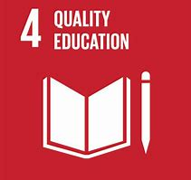
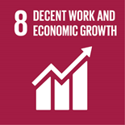
Global Trends and Challenges
Technology disruption
CAD ex Blockchain certificate
Notes:
Given I started of talking about robots and automation, of course I have to begin with technology disruption!
The meteoric rise of online learning and the impact of technology on teaching, learning and administration serve as constant disruptors. As technology continues to integrate and change the world we live in, higher education must also change and integrate new technology in order to prepare students for in-demand jobs.
An example here is George Brown College launching Canada’s first comprehensive certificate program in blockchain technology to help address a serious shortage of developer talent in the growing field.
I will just note here that I have included the most relevant SDGs attached to each of the trends I will present.

Slide 14
Global Trends and Challenges cont.
Technology disruption
USA ex Woz U
Notes:
The international example I want to point you to here is Woz U – the latest project of Steve Wozniak, famous co-founder of Apple. This is an online platform where students have 24/7 access to online programs with LIVE access to instructors and mentors, high-quality video-based curriculum, and comprehensive career services. How will traditional higher ed compete?!
DO NOT READ
RBC – mobility map of skills to identify those that compose occupations – ex coding for coal miners
UK - +connect

Slide 15
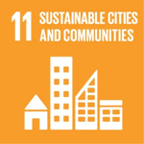
Global Trends and Challenges cont.
2. Shifting demographics
CAD ex Centre for Elder Research
Notes:
-The second trend I want to mention is shifting demographics. Around the globe there is a decline in the youth population and an increase in the senior population. In fact, it is projected that Africa is the only place where the youth population will continue to grow until 2025.
In Canadian colleges and institutes, programs and services both reflect this. An example here is the huge increases in programming for in-demand fields like healthcare for aging populations and “aging” research using smart apartments, wearable technology and virtual reality. Sheridan College’s Centre for Elder Research has been conducting innovative Lab to Life® research for over 15 years, enhancing the quality of life of older adults while serving as an education and research hub for the community.

Slide 16
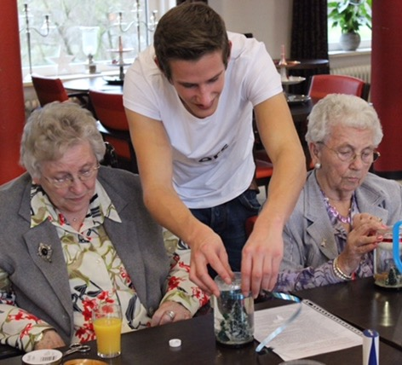
2. Shifting demographics
NLD ex Students living free in retirement homes
Notes:
The international example I want to share is in the Netherlands who, based on a program in Spain from the 90’s, has retirement homes that are allowing PSE students to live rent-free alongside the elderly residents. Students are required to spend at least 30 hours per month acting as “good neighbors” helping with things like errands and company. This shows how innovative we can be when it comes to addressing the needs of aging populations via different elements of higher education.

Slide 17
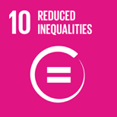
Global Trends and Challenges cont.
3. Diversity of learners and focus on student experience
CAD ex mental health programs and support services
Notes:
- Related to changing demographics is the new diversity of learners on campus. The new focus on education for all - ensuring education for women and other disadvantaged groups – and the pressure to reskill or upskill to find meaningful work, results in students of different ages, backgrounds, etc. all together in our institutions. With this diversity comes the need to meet a wide range of student expectations, everything from feeling welcome on campus for immigrants to valuable career services and tailored support. Creating and nurturing quality student experiences with the aim of retaining both national and international students is key in this climate.
An example here is college and institutes focus on mental health – over one fifth of postsecondary students report being depressed/anxious/battling other mental health issues according to reports. Strengthening the support systems for students (and faculty) to ensure availability of resources and appropriate mental health services is a key focus - almost all colleges have robust mental health support services for students from helplines, to culturally appropriate access to elders for indigenous students. Institutions are also creating many programs to prepare workers to deal with mental health issues: for example, Langara College and JIBC both offer courses to help paramedics, personal-support workers, and other first responders deal with mental health and post-traumatic stress.
DO NOT READ
Ex – pathways between types of institutions in Canada
Bow Valley Immigration

Slide 18
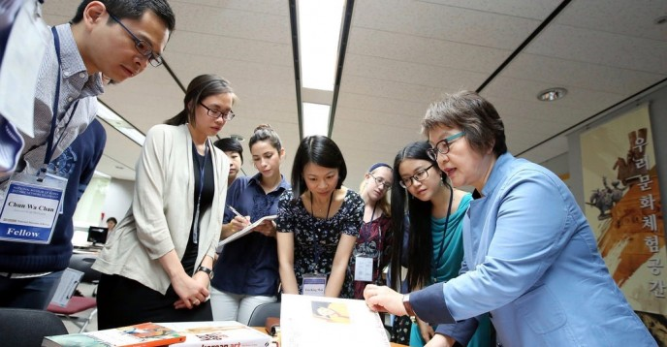
Global Trends and Challenges cont.
3. Diversity of learners and focus on student experience
KOR ex Credit Bank System
Notes:
Internationally, I want to share an example that is responding to learner preferences and adapting education to meet their needs. The Academic Credit Bank System in the Republic of Korea is a central agency for continuing education that recognizes diverse learning experiences from both school AND out-of-school. When a learner accumulates the necessary CBS-approved credits, he/she can be awarded a degree. How cool to see a program adapted to the fulsome way we actually acquire skills!
DO NOT READ
Finland flexible admission and study time

Slide 19
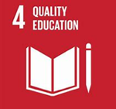
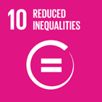
Global Trends and Challenges cont.
4. Internationalization (protectionism vs. opening borders)
CAD ex global citizenship elements in all programs
Notes:
Next up is Internationalization or globalization
Governments, businesses and educational institutions are all focused on this – international politics, global marketplaces etc. We often make the link to national prosperity via trade and economic growth, as well as the recruitment and training of skilled workers for labor shortages. In a globalized world, we see all of these elements playing out in PSE. Trump’s America and Brexit are demonstrating how closing borders and protectionist world views are changing the international student landscape, while Canada stands in stark contrast with its commitment to open borders and preparing citizens for a global labour market.
An example of how Canadian colleges and institutes are tackling this is Centennial’s Global Citizenship & Equity Outcomes – They have identified 6 learning outcomes that have been embedded into almost all programs, preparing students to succeed in the global marketplace. These outcomes require students to develop global citizenship, equity and inclusion knowledge, skills and experiences as it relates to the sustainability of resources, individual and community identities, critical social analysis and enhanced personal and social responsibility.
DO NOT READ (for reference only):
Centennial’s 6 GCEI learning outcomes:
1 Identify one’s roles and responsibilities as a global citizen in personal and professional life.
2 Identify beliefs, values and behaviours that form individual and community identities and the basis for respectful relationships.
3 Analyze issues of equity at the personal, professional and global level.
4 Analyze the use of the world’s resources to achieve sustainability and equitable distribution at the personal, professional and global level.
5 Identify and challenge unjust practices in local and global systems.
6 Support personal and social responsibility initiatives at the local, national or global level.

Slide 20
Global Trends and Challenges cont.
4. Internationalization (protectionism vs. opening borders)
BRA ex Science Without Borders
Notes:
The international example I will site here is Brazil’s Science Without Borders program. This national scholarship program promoted the expansion and internationalization of science, technology, and innovation to improve Brazilian competitiveness via international mobility of PSE students and researchers. With 100,000 scholarships funded, the greatest achievement has perhaps been the dialogue between Brazilian higher education Institutions and their counterparts all over the world.

Slide 21
Global Trends and Challenges cont.
5. Indigenous learners
CAD ex Institute of Indigenous Self-Determination
Notes:
Almost all countries settled by Europeans are working to reconcile with the Indigenous peoples whose lands we occupy. Helping these individuals find inclusion in education and the support they need to thrive is critical. Canada has focused a great deal in the past few years on reconciliation with its Indigenous peoples and colleges and institutes are leaders in this space given they are community-based and located in many rural and remote areas.
An example here is Yukon College’s Institute of Indigenous Self-Determination – they work closely with all of the fourteen Yukon First Nations and give students the opportunity to learn from Indigenous leaders and professionals while also connecting researchers with Indigenous communities to help find solutions to northern challenges.
DO NOT READ
Other examples:
-Okanagan College Aboriginal Community Support Worker (ACSW) program was designed through extensive consultation with Indigenous communities in British Columbia and tackles the growing need for social and community support workers with a deeper knowledge of the specific challenges facing Indigenous individuals and families.
-Saskatchewan Polytechnic has recently launched a new Indigenous Student Success Strategy (June 2018).
-Yukon College Bachelor of Arts in Indigenous Governance developed in consultation with 14 Yukon First Nations designed to support the realization of Yukon First Nations self-government initiatives.
-Capilano University new University One for Aboriginal Learners is an eight-month program intended to help Aboriginal, Métis and Inuit students establish ground that will prepare them for further post-secondary education.
-Confederation College’s Centre for Policy and Research in Indigenous Learning (CPRIL) is the first and only college-based Indigenous education policy and research centre in Canada, and works closely the Negahneewin Council to facilitate inclusive dialogue on Indigenous learning and develop evidence-based policy to support Indigenous students. The college also trains students in social, legal, and political issues affecting Indigenous populations through the Aboriginal Community Advocacy.
-Native Education College has established strategic partnerships with First Nations and Indigenous agencies throughout British Columbia to deliver accredited post-secondary and adult-upgrading programs developed with Indigenous content and teaching methods while allowing the learners to remain in their communities.
-The Collège communautaire du Nouveau-Brunswick (CCNB) has worked with a number of local First Nations community partners to identify and help coordinate culturally sensitive Indigenous programming that responds to the unique educational needs of the community, and now incorporates Indigenous teaching methods in its programs, including talking circles and regular classroom visits from local Elders.

Slide 22
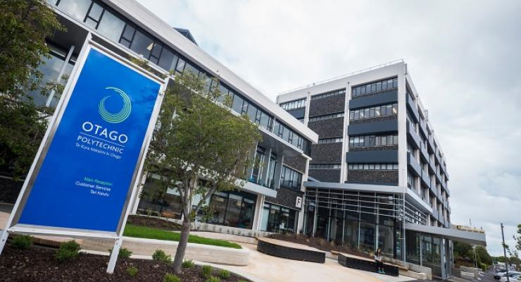
Global Trends and Challenges cont.
5. Indigenous learners
NZ ex Otago Polytechnic
Notes:
Internationally, Otago Polytechnic in New Zealand is an incredible institution that has evolved in partnership with its indigenous community. They have committed to staff proportionate to M¯aori learners, embedding M¯aori knowledge and perspectives in all programmes, and much more.

Slide 23
Global Trends and Challenges cont.
6. Lifelong learning/ reskilling
CAD ex wind turbine technician
Notes:
With quickly changing technology having an impact on all sectors of the economy, and thus on all jobs, the importance of life-long learning and upskilling has never been greater. Higher education institutions have a unique opportunity to become hubs of knowledge, mentoring and networking for our learners over their lifespan.
An example of adapting to this changing world is targeting displaced workers who’s roles have been made obsolete by technology. At Lethbridge College they have a wind turbine technician training program for laid off oil and gas workers to equip them to work in a new field.
DO NOT READ
Other examples
BCIT’s SITE is an advanced placement and prior learning assessment model developed for returning military veterans, but now widely used to help attribute individuals personalized skills and giving them classroom credit for previous work and life experience.

Slide 24
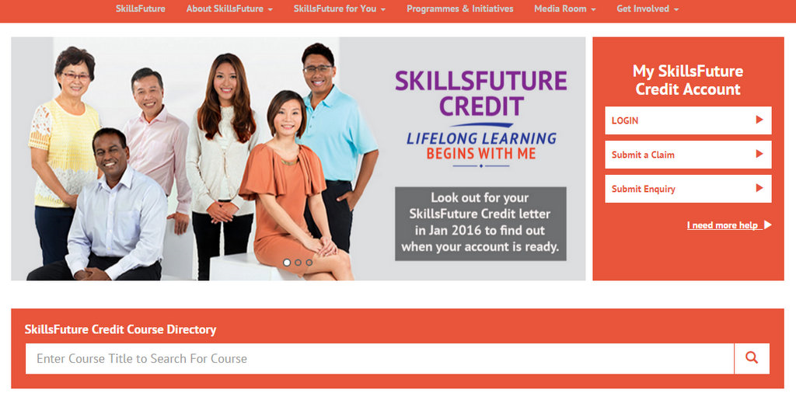
Global Trends and Challenges cont.
6. Lifelong learning/ reskilling
SGP ex SkillsFuture Credit
Notes:
Iinternationally, Singapore’s SkillsFuture Credit, is an innovative government program that offers direct subsidies to all Singapore citizens over the age of 25 (with higher subsidies for mid-career professionals). In 2016, the program encompassed over 18,000 courses and was used by over 126,000 Singaporeans.
DO NOT READ
Scotland – yellow ribbon program giving credits for military experience (have a database for credits and programs etc)

Slide 25
Global Trends and Challenges cont.
7. Climate change
CAD ex Education for Sustainability
faculty course
Notes:
We can’t go anywhere these days without hearing about climate change. It is having an impact on everything we do, from tourism to agriculture, to new sectors of the economy like clean technologies and ecological restoration. With huge strength in this area because of our abundance of natural resources, Canada has developed some very exciting ways of preparing employees for this new world of work.
The example I want to share here is Nova Scotia Community College – they have created the Education for Sustainability (EFS) faculty development course – a five day, 39-hour course
devoted to the examination of sustainability through the lens of higher education. It is required of all NSCC faculty and professional support employees to ensure this focus permeates all that they do and teach.
DO NOT READ
Other examples
Yukon College program in Climate Change Policy
Ecological Restoration (joint program with Trent), Environmental Technology and Advanced Water Systems Operations and Management offered through the Fleming College Centre for the Advancement of Wastewater Technologies
Sheridan College Environmental Control graduate certificate
Kwantlen Polytechnic Bachelor of Applied Science in Sustainable Agriculture

Slide 26
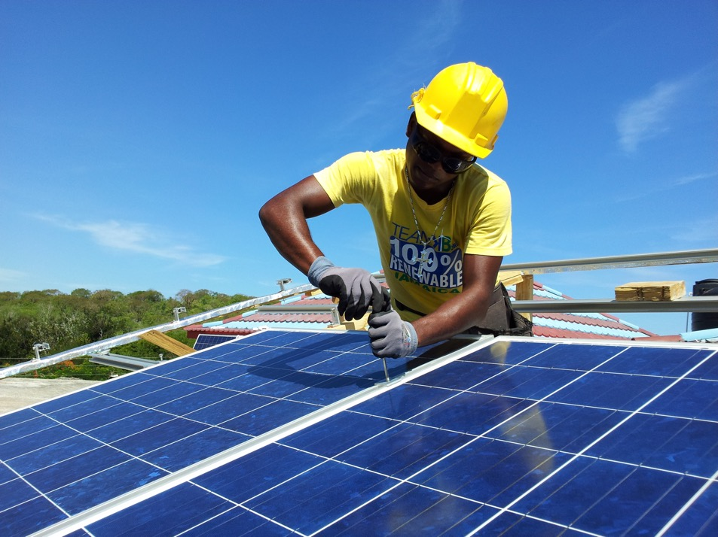
Global Trends and Challenges cont.
7. Climate change
JAM ex solar panel technician training
Notes:
An interesting international example here is from CICan’s Caribbean Education for Employment program in Jamaica. PSE institutions developed the curriculum they needed to train solar panel technicians. Given the abundance of sun, and the high price of electricity, Jamaica has leapt onto solar panel installation but of course, soon found they needed people to maintain them.

Slide 27
Global Trends and Challenges cont.
8. Changing models of work
CAD ex Institute for Indigenous Entrepreneurship
Notes:
Not only do we have to respond to changing climates, we also have to address the changing world of work. We no longer live in an era of being hired right out of school into the company we will retire from – people switch jobs and change careers regularly. We now have what many are calling a gig economy (as opposed to “career”) and there is a huge focus on entrepreneurship and start-up companies that are often short lived. Needless to say, preparing our students to thrive in this new environment is key, and Canadian colleges and institutes are doing a lot of interesting work in this area.
The one example I will mention here is Algonquin College’s Institute for Indigenous Entrepreneurship. In addition to their IgniteAC Centre for Innovation and Entrepreneurship, this centre was designed in consultation with indigenous communities and based on indigenous business principles. When indigenous learners arrive at Algonquin College, they find a place that echoes their heritage and provides the kind of foundation they need to succeed in this uncertain world.
DO NOT READ
Other examples
Conestoga College Centre for Entrepreneurship (C4E)
Le parcours Entrepreneuriat-études au Cégep Limoilou

Slide 28
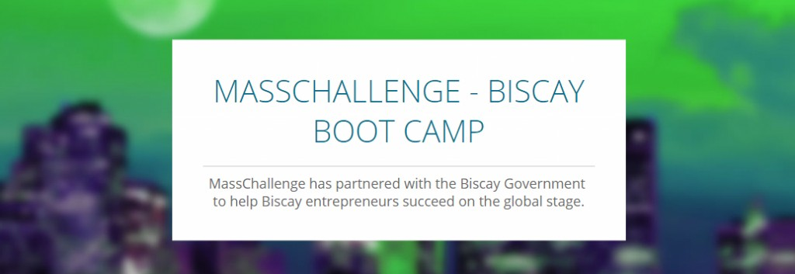
Global Trends and Challenges cont.
8. Changing models of work
Basque ex entrepreneurship bootcamp
Notes:
Similarly, the Basque region is supporting aspiring entrepreneurs with short four-day boot camps customized by MassChallenge to the Basque region.

Slide 29
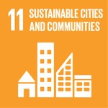
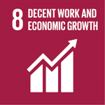
Global Trends and Challenges cont.
9. Linking industry and labour market information to education
CAD ex addressing cannabis legalization
Notes:
- linking business and industry to higher education is critical topic.
As employers’ experience challenges in hiring graduates with workforce-ready skills, there is a push for more cooperation between industry and higher education globally. This will come as no surprise to those of you who are leaders in this area. We have seen that with the future of automation, it’s expected that the workplace will undergo a dramatic transformation. Higher education institutions will need to stay ahead of these changes to ensure that graduates get appropriate workplace-ready and transferable skills.
Canadian colleges and institutes have deep ties to industry as you heard me describe earlier, but a specific example here is how our system is responding to Canada’s impending Cannabis legalization. Colleges and Institutes, too many to list, are leading the response to all of the different needs arising in this area. Curriculum and programs have been developed, from production, to cultivation, to commercialization, and new research labs.
DO NOT READ
PACs

Slide 30
Global Trends and Challenges cont.
9. Linking industry and labour market information to education
DEU ex Industry Clusters
Notes:
My international example here is Germany – We all know its famous apprenticeship system is linked to industry, but I want to highlight the innovative way they have tackled extending this to SMEs, who also need highly skilled labour, but don’t have the necessary resources on their own. They have created Industry Clusters to tackle this – it’s a win-win!

Slide 31
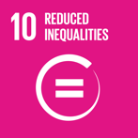
Global Trends and Challenges cont.
10. Parity of esteem
CAD ex 10,000+ programs
Notes:
- And finally, the last topic I will mention is parity of esteem. We have a system that has largely evolved from vocational and trades training – it was often the fall back choice for students who were not believed to be capable of university education. Professional and technical training has today evolved a great deal and is at the cutting edge of training and applied learning, but it is not always seen as a valuable path to a respected career; there has been too much focus on university in most countries, with little recognition for the evolution of the TVET system and how leading edge this option has become in many contexts.
The example I will give you here is simply a number – there are over 10,000 programs offered by colleges and institutes in Canada. This includes a wide range of degree, diploma and post-graduate specializations, all tailored to industry and the jobs of the future.
DO NOT READ
Ex George Brown Job Talk

Slide 32
Global Trends and Challenges cont.
10. Parity of esteem
EUR ex TVET week
Notes:
Internationally, we see broad recognition coming via examples like the third edition of the European Vocational Skills Week, that will take place in November 2018
DO NOT READ
Singapore training counsellors on TVET (parents too!)

Slide 33
Notes:
Now for my parting thought I want to share the May 5, 1958 edition of Arthur Radebaugh's Sunday comic, Closer Than We Think. This was his vision, 60 years ago, of the high-tech school of tomorrow- push button education.
Looks pretty realistic doesn’t it! Maybe except for the student in his personal helicopter outside.

Slide 34
Notes:
SO, what do we think the classroom will look like in another 60 years when this is the new world order.
Tobi is the CEO of Shopify, one of the fastest growing and most innovative tech firms in the world. Here he is here echoing google, apple, and IBM in saying that they don’t care about academic acheivments. In a world where credentials don’t matter – how will be all prepare our students to thrive?!

Slide 35
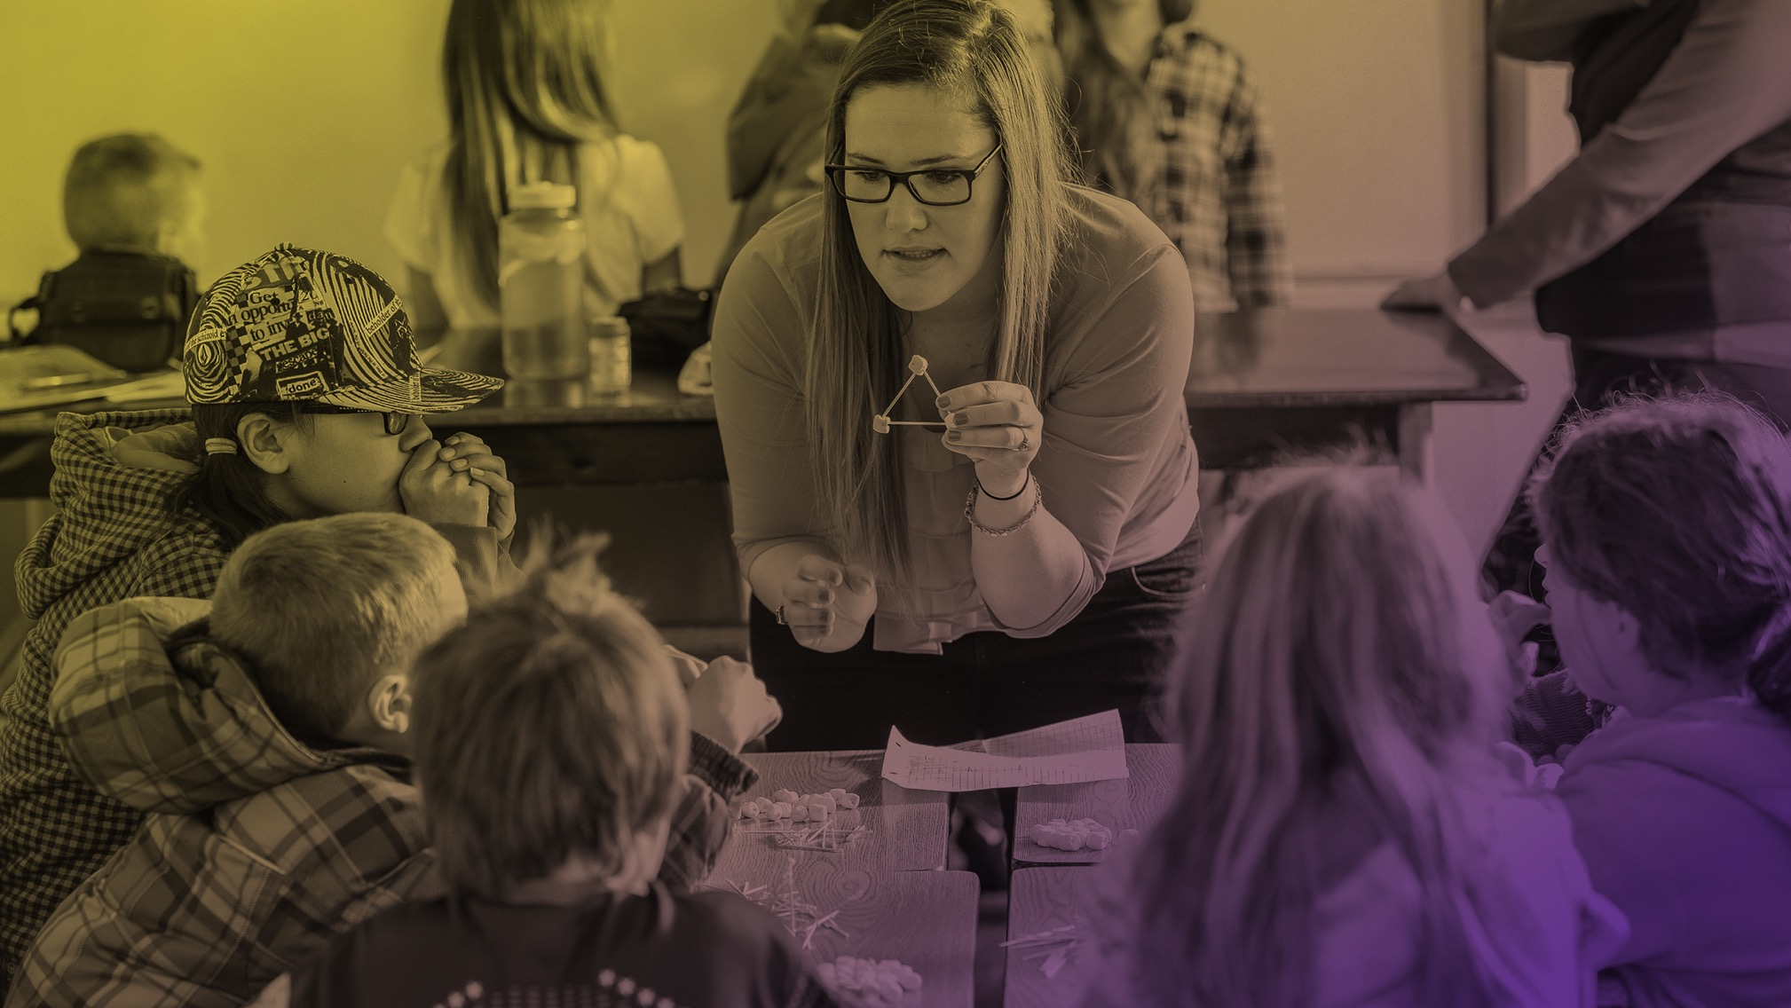
Thank You/ Merci
Notes:
Thank you very much for your time!

Slide 36
Thank You
Denise Amyot
President & CEO
Colleges and Institutes Canada (CICan)
damyot@collegesinstitutes.ca
collegesinstitutes.ca
@CollegeCan
University of the Fraser Valley
Notes:
Please don’t hesitate to contact me!

