Slide 1
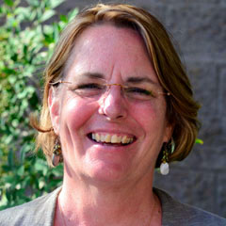
Changing Perspectives in Quality Instruction: Quality Matters @ Yavapai College
Professor Lindsay Henning
Program Director, QM@YC
Notes:
Thanks for joining me!
My name is Lindsay and I will introduce you to QM@YC and what it might mean to you. When I was considering the theme of this conference, Changing Perspectives, I realized the perspectives I see changing are those of our professors who teach online and blended. I would like to tell you our Quality Matters story...
Ready to begin?

Slide 2
Today, we will:
Explore Quality Matters© basic concepts
Discuss how and why QM concepts can be applied to all disciplines and course modalities
Discover how QM impacted our online/hybrid programs
Share lessons learned

Slide 3
The QM Approach
QM is a faculty-driven, peer review process that is…
Collaborative
Collegial
Continuous
Centered
in academic foundation
around student learning
Notes:
Pima Community College:
Janice Kempster - jkempster@pima.edu
Michael Amick - mamick1@pima.edu
Robert Foth - rfoth@pima.edu

Slide 4
What is Quality Matters?
A set of Standards (Rubric) for the design of online and blended courses
6th Edition released July 1
A peer review process (faculty mentoring faculty) for reviewing and improving online and blended courses
A course development tool for faculty and instructional development staff
A professional development opportunity
An opportunity to participate in a community dedicated to quality in online and blended courses
Notes:
What is Quality Matters? That is the question, isn’t it?
It is a number of things all having to do with how we through our courses interact with our online and hybrid students:
A set of Standards (Rubric) for the design of online and blended courses
A peer review process (faculty for faculty) for reviewing and improving online and blended courses
A course development tool for faculty and instructional development staff
A professional development opportunity
An opportunity to participate in a community dedicated to quality in online courses

Slide 5
What QM is NOT About…
Not about an individual instructor
(it’s about the course)
Not about faculty evaluation
(it’s about course quality)
Not about judgment
(it’s about diagnosis and improvement)
Not about “win/lose” or “pass/fail”
(it’s about continuous improvement in a supportive environment)
Notes:
One of the things I learned a long time ago was the human brain does not operate well in the negative. For example, the last time you told a toddler NOT to touch a hot stove, what was the first thing he or she wanted to do? Touch!
When a person is walking a narrow ledge, they are told NOT to look down… and they surely look!
Knowing this, I am knowingly entering the “NOT” zone – and watch for the positive spins…
Quality Matters is:
•Not about an individual instructor
(it’s about the course)
•Not about faculty evaluation
(it’s about course quality)
•Not about judgment
(it’s about diagnosis and improvement)
•Not about “win/lose” or “pass/fail”
(it’s about continuous improvement in a supportive environment)

Slide 6
Online vs F2F: environment
Online Face-to-Face
Pedagogical Mostly asynchronous interaction Mostly synchronous interaction
Operational Class is in session 24/7 Same place, same time
Students Often working professionals, Often live close, schedule allows often dispersed for classroom sessions
Role of Instructor Facilitator; helps students Lecturer; “Sage on the Stage”,
construct knowledge transfers knowledge to students
Notes:
The goals of an online course are the same as a f2f class. The challenges are the same, as well. How do you increase the motivation of your students? What do you do?
https://ep.jhu.edu/faculty/learning-roadmap-for-new-online-instructors/comparing-face-to-face-and-online-teaching

Slide 7
Online vs F2F: QM Standard 1.1
“Instructions make clear how to get started and where to find various course components.”
 | Online | F2F
1st day of class | Introductions, review syllabus | Introductions, review syllabus
Learning Units | Introduced in[online] class, questions answered | Introduced in class, questions answered
Feedback & Help | Online discussions, grading of activities and projects | In class discussions, grading of activities and projects
Notes:
The goals of on online course are the same as a f2f class. The challenges are the same, as well. How do you increase the motivation of your students? What do you do?
https://ep.jhu.edu/faculty/learning-roadmap-for-new-online-instructors/comparing-face-to-face-and-online-teaching

Slide 8
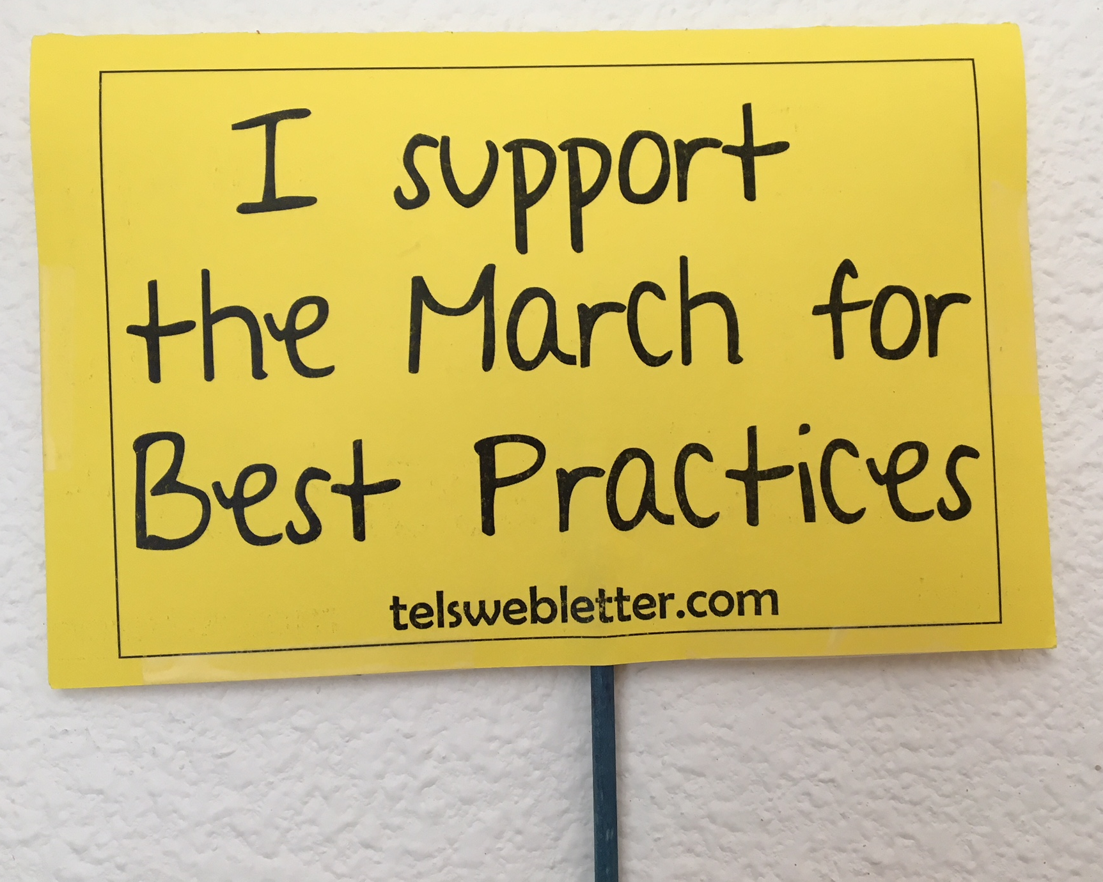
History of QM@YC
2014: Join the AZ Consortium
2014: 1st Apply the QM Rubric
March for Best Practices
2016: QM@YC launched
2017: QM Essentials Self-Review process implemented
2017: 1st QM Certified course
2018: 1st Improve Your Online Course
2018: YC Essential Reviews: 300/100
9 courses QM Certified
Notes:
Let me tell you a bit about Quality Matters at Yavapai College!
The first APPQMR (the Apply the Quality Matters Rubric) training was hosted and sponsored by our TeLS department in 2014 as part of the March for Best Practices movement. Our first faculty were introduced to the concepts of continuous, collegial, collaborative, and faculty-centered evaluation of our own online courses. The focus is not on judging faculty, but on the success and retention of our students.

Slide 9
QM@YC Members
Who is involved?
131 faculty and staff
99 completed training
9 Peer Reviewers
2 Master Reviewers
3 QM-Certified Workshop instructors
Notes:
Since the beginning of this project, there have been over 90 full and part-time faculty trained in the basic course: the APPQMR. We now have as our in-house team seven peer reviewers, two face to face instructors, and one master reviewer.
This course and others in this series are another way to learn the concepts of Quality Matters and apply them to your own online or hybrid courses in a J.I.T. (just in time) manner.

Slide 10
Lessons Learned...
Let go of what we (thought we)knew,
Gather key stakeholders,
Faculty
Administration
IT/TeLS
Walk the talk,
Educate, educate, educate

Slide 11
Questions? Thank you!

