Slide 1
Max Wilson
Friends of the Verde River

Slide 2
Water Use
Development

Slide 3
Water Use
Development

Slide 4
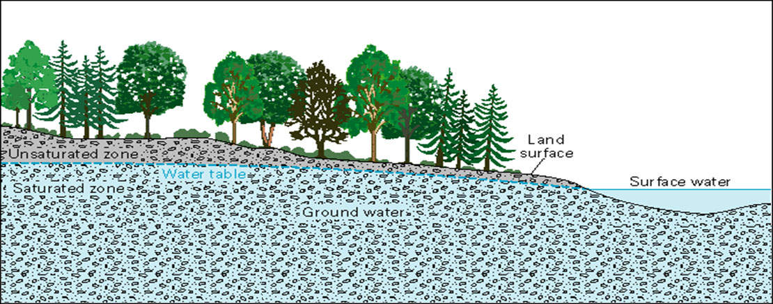
Image: USGS

Slide 5
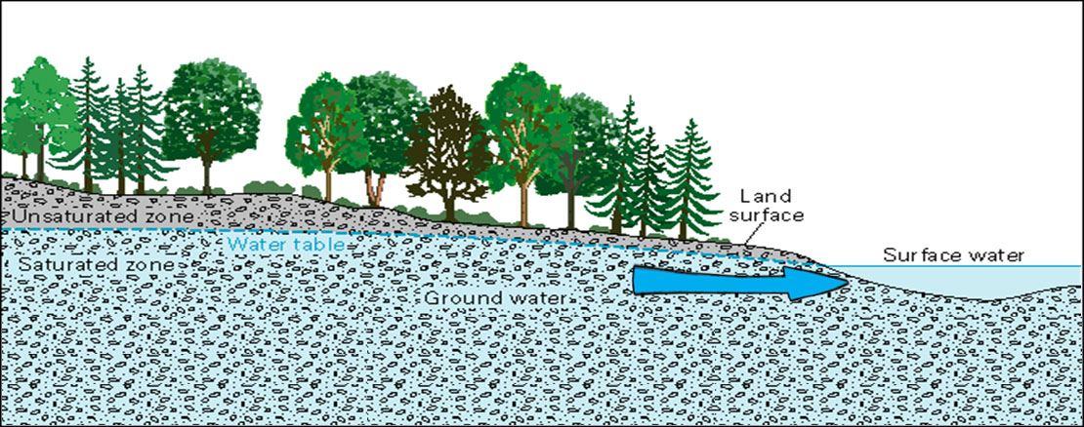

Slide 6
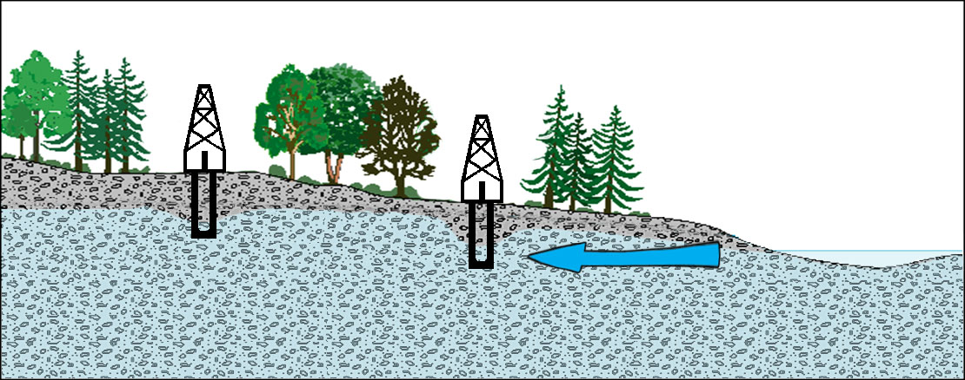

Slide 7
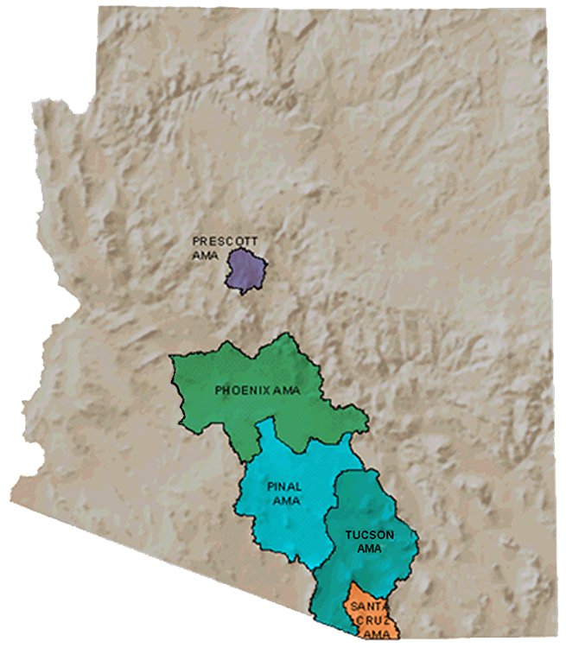
Arizona AMAs
Data: ADWR

Slide 8
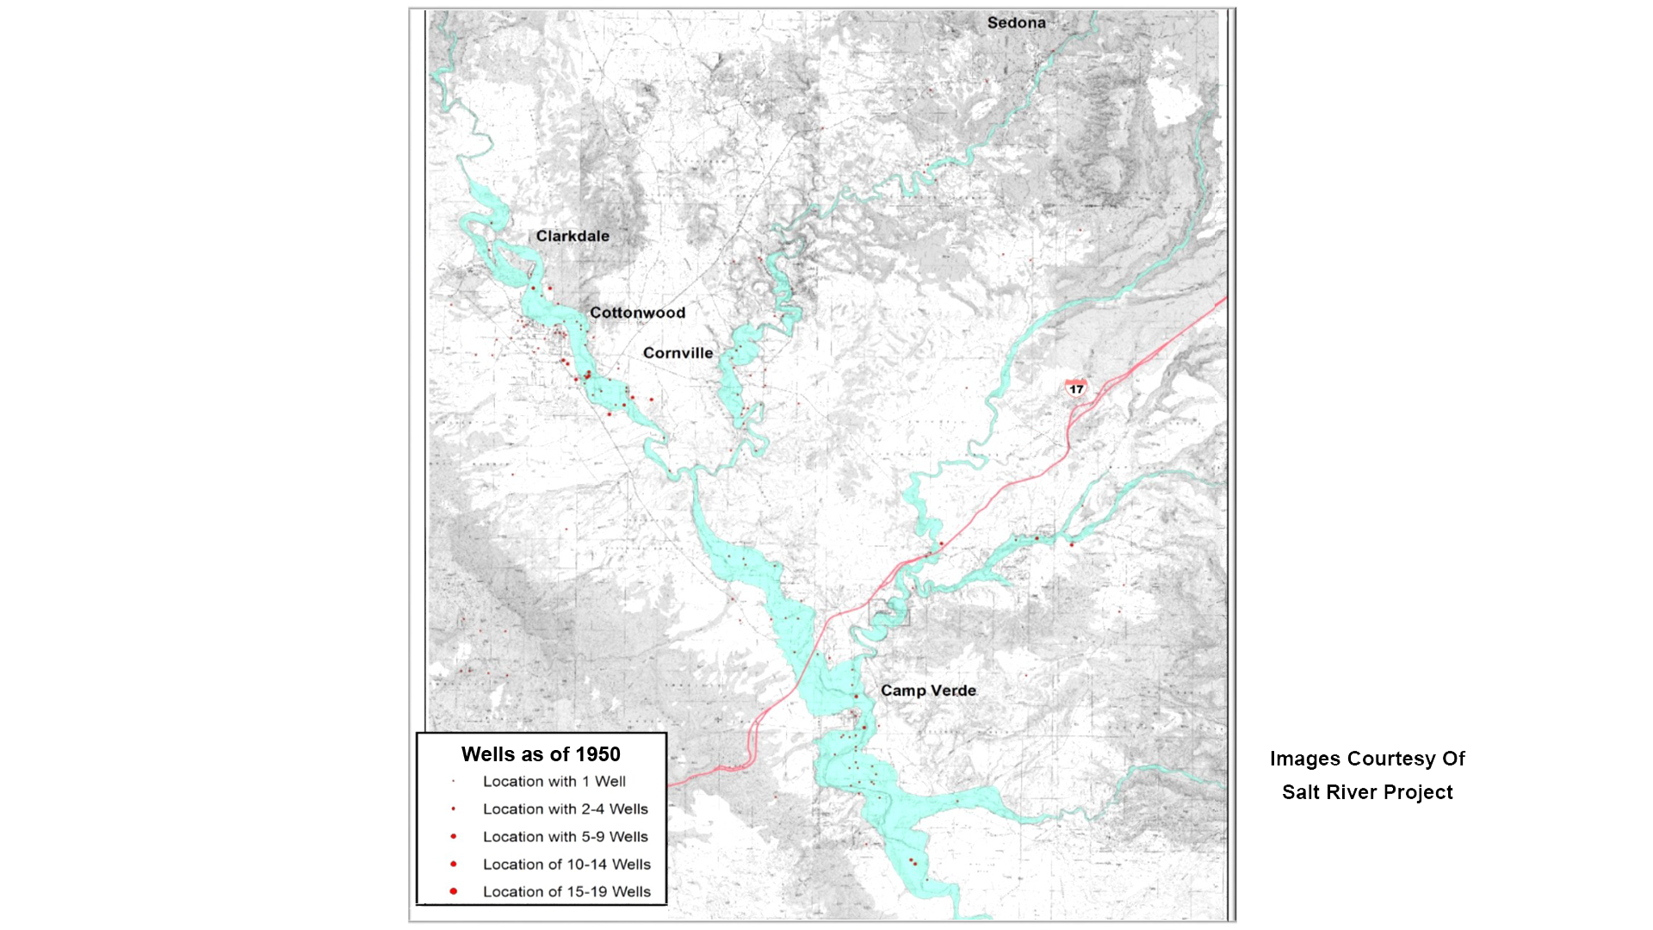
1950

Slide 9
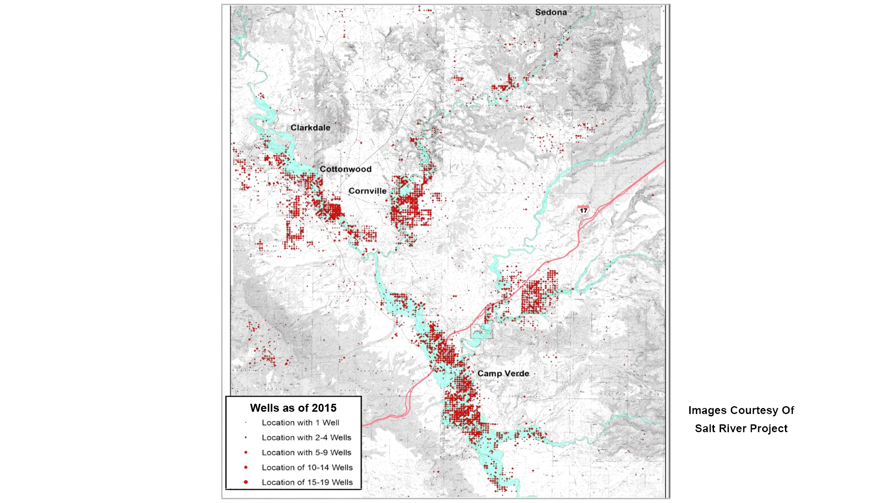
2015

Slide 10
Building a Local Solution

Slide 11
Program Origin, Values
Implement actionable local solutions that work in the larger AZ water rights and water politics picture
Respect local economic, environmental and social values
Preserve property rights and individual water users’ autonomy

Slide 12
Program Origin, Values
Ensure collaboration and shared stewardship among water users and community members from different sectors
Focus on a positive, voluntary and proactive approach
Address underlying long-term issues

Slide 13
Funders and Partners Include…

Slide 14
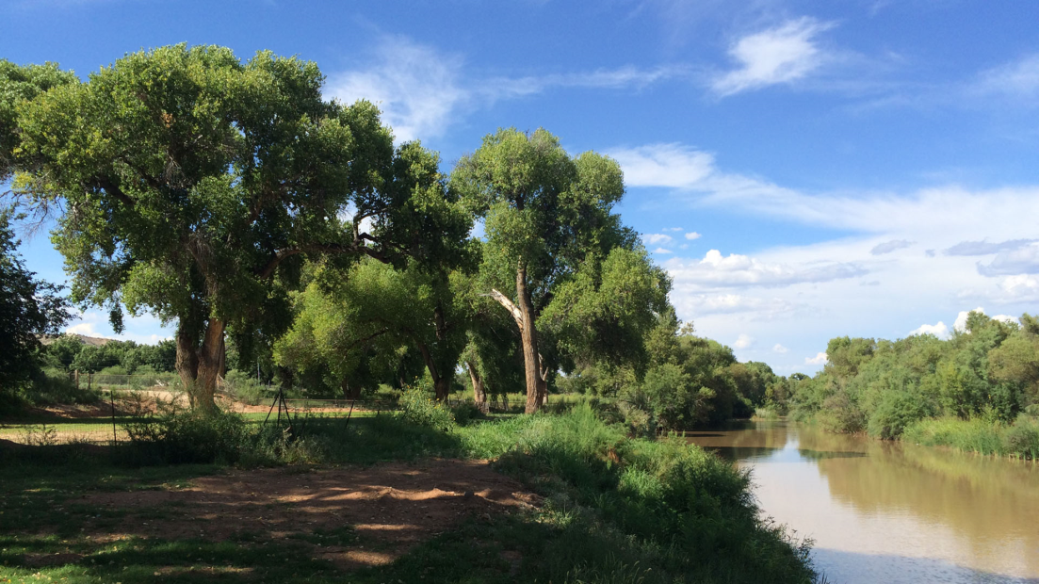
What is the Verde River Exchange?
Provides a mechanism for groundwater users to “offset” the impact of their groundwater pumping on the Verde River

Slide 15
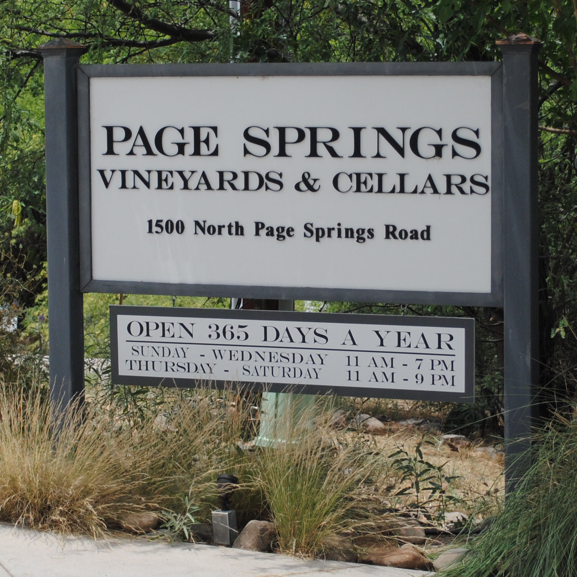
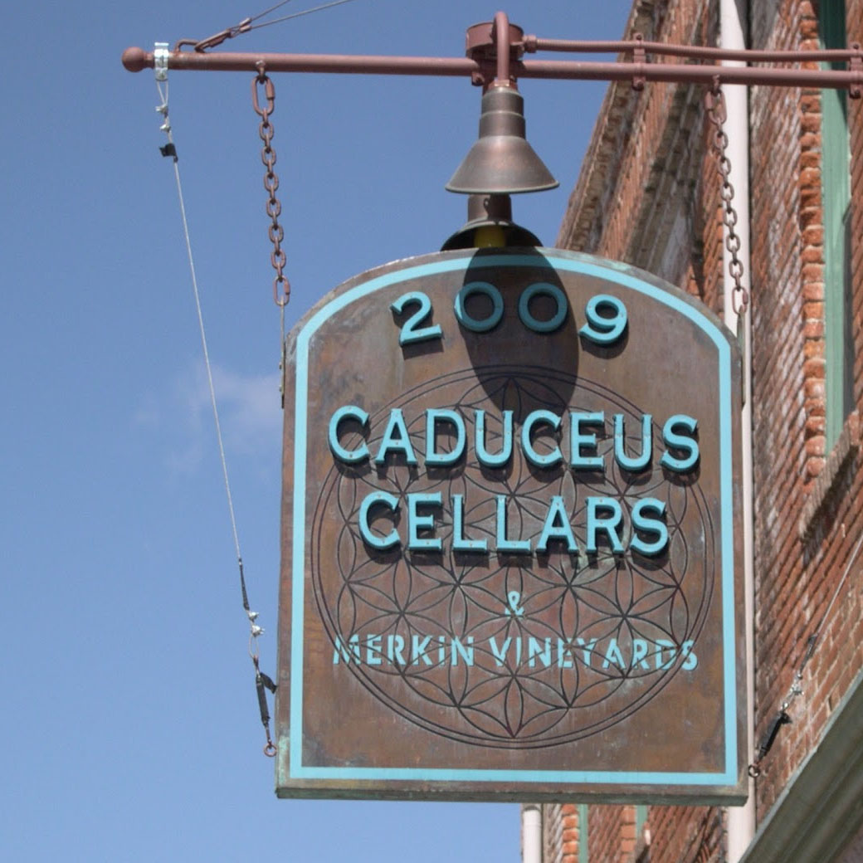
2016 Pilot Projects

Slide 16
2017 Pilot Projects
Water Offset Credit Buyers, 2017:
Caduceus Cellars/Merkin Vineyards
The Fish’s Garden
Page Springs Cellars & Vineyards
Out of Africa Wildlife Park

Slide 17
What’s Next

Slide 18
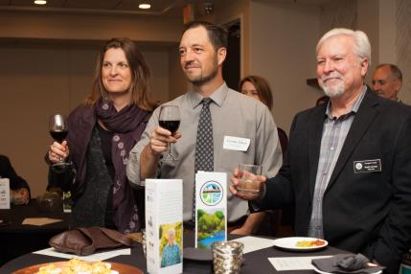
Building our Program
Increase number of projects
Expand scope and duration of offsets
Incentivize participation

Slide 19
Water Use
Development

Slide 20
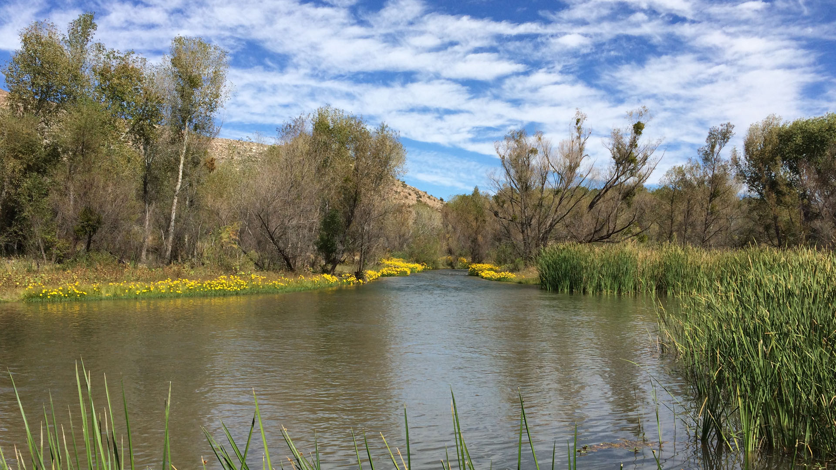
Thank you and final image.
www.verderiverexchange.org

